Slide 1
2-<number>

Slide 2
PROJECTS
Unique, one-time operations designed to accomplish a specific set of objectives in a limited time frame.
Constraints – Scope, Time, Cost & Operations.

Slide 3
PROJECT MANAGEMENT (CONTD.)
How is it different?
  Limited time frame
  Narrow focus, specific objectives
  Less bureaucratic
Why is it used?
  Special needs
  Pressures for new or improves products or services

Slide 4
PROJECT MANAGEMENT (CONTD.)
What are the Key Success Factors?
  Top-down commitment
  Having a capable project manager
  Having time to plan
  Careful tracking and control
  Good communications

Slide 5
KEY DECISIONS IN PROJECT MANAGEMENT
Deciding which projects to implement
Selecting the project manager
Selecting the project team
Planning and designing the project
Managing and controlling project resources
Deciding if and when a project should be terminated

Slide 6
PROJECT INITIATION NEEDS
Projects are typically authorized as a result of one or more of the following strategic considerations:
  A market demand
    (e.g., an oil company authorizes a project to build a new refinery in response to chronic gasoline shortages)
  An organizational need
    (e.g., a training company authorizes a project to create a new course in order to increase its revenues)
  A customer request
    (e.g., an electric utility authorizes a project to build a new substation to serve a new industrial park)
  A technological advance
    (e.g., a software firm authorizes a new project to develop a new generation of video games after the introduction of new game- playing equipment by electronics firms)
  A legal requirement
    (e.g., a paint manufacturer authorizes a project to establish guidelines for the handling of a new toxic material).

Slide 7


PROJECT MANAGER
Responsibilities …
Work Quality
Human Resources Time
Communications Costs

Slide 8
PROJECT DELIVERABLES
Any unique and confirmable product, result, or capability to perform a service that must be produced to complete a project.
Deliverables include both the outputs that comprise the product or service of the project, as well as ancillary results, such as project management reports and documentation.
Depending on the project scope statement, the deliverables may be described at a summary level or in great detail.
List of formal deliverables
  Requirement Document
    Business needs, purpose, expectations management, refinement
    Table of contents, executive summary
  Final product, service, or result
  Acceptance criteria (What, Who, How)

Slide 9
PROJECT MANAGEMENT TOOLS
Project Management Tools are -
  Work breakdown structure
  Network/Precedence diagram
    AOA
    AON
  Scheduling and Sequencing

Slide 10



























WORK BREAKDOWN STRUCTURE
Project X
Level 1
Level 2
Level 3
Level 4

Slide 11
DRAW PRECEDENCE DIAGRAM AND FIND CRITICAL PATH AND EXPECTED PROJECT DURATION
ACITIVITY | Duration | Immediate Predecessor
A | – 1 Day | – n/a
B | – 2 Days | – n/a
C | – 3 Days | – n/a
D | – 4 Days | – A
E | – 5 Days | – B
F | – 4 Days | – B
G | – 6 Days | – C
H | – 6 Days | – D, E
I | – 2 Days | – G
J | – 3 Days | – H, F, I

Slide 12
CRITICAL PATH ANALYSIS
  - Also called critical path method - is a network diagramming technique used to predict total project duration.
- A critical path is the series of activities that determine the earliest time by which the project can be completed.
- The longest path or the path containing the critical tasks is what is driving the completion date for the project

Slide 13
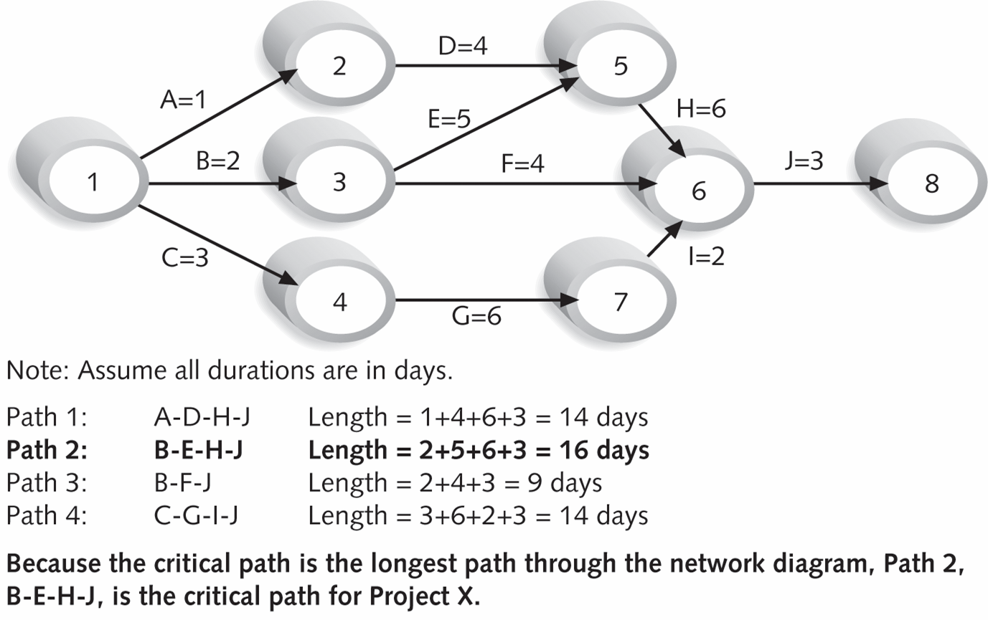
PRECEDENCE DIAGRAM (AOA)
Path 1: A – D – H – J
Path 2: B – E – H – J
Path 3: B – F – J
Path 4: C – G – I – J
Length = ?
Length = ?
Length = ?
Length = ?

